Slide 1


Slide 2
How does an agent make decisions?

Slide 3
Search
Search is a universal problem solving mechanism in artificial intelligence
Search algorithms:
Uninformed search or Brute force search
Heuristic search or informed search

Slide 4
Search
Uninformed search or Brute force search
While a brute-force search is simple to implement, and will always find a solution if it exists, its cost is proportional to the number of candidate solutions.
It is a blind search algorithm
Including:
Breadth first search algorithm
Depth first search algorithm
Iterative deepening search

Slide 5
Search
Heuristic search or informed search
Heuristic is a technique designed for solving a problem more quickly when classic methods are too slow.
Including:
A* algorithm
Iterative deepening a*

Slide 6
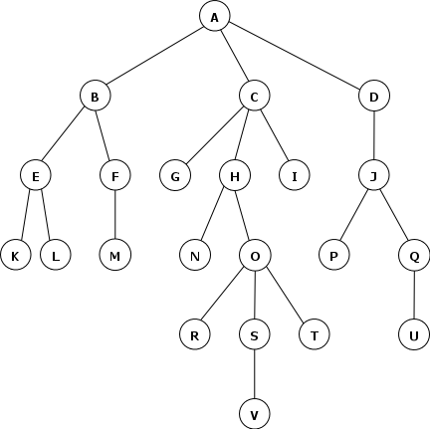
Breadth First Search
Strategy: expand the shallowest unexpanded node.
Implementation: FIFO queue.

Slide 7
Breadth First Search
The queue evolves like this
A
B C D
C D E F
D E F G H I
E F G H I J
F G H I J K L
G H I J K L M
H I J K L M
I J K L M N O
J K L M N O
K L M N O P Q
L M N O P Q
M N O P Q
N O P Q
O P Q
P Q R S T
Q R S T
R S T U
S T U
T U V
U V
V

Slide 8
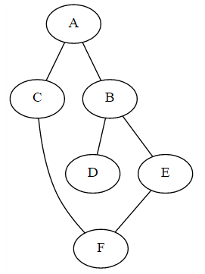
Breadth First using Python
graph = {'A': set(['B', 'C']),
'B': set(['A', 'D', 'E']),
'C': set(['A', 'F']),
'D': set(['B']),
'E': set(['B', 'F']),
'F': set(['C', 'E'])}

Slide 9
Breadth First using Python
def bfs_paths(graph, start, goal):
paths = []
queue = [(start, [start])]
while queue:
(vertex, path) = queue.pop(0)
for next in graph[vertex] - set(path):
if next == goal:
paths.append(path + [next])
else:
queue.append((next, path + [next]))
return paths
print bfs_paths(graph, 'A', 'F')
# [['A', 'C', 'F'], ['A', 'B', 'E', 'F']]

Slide 10
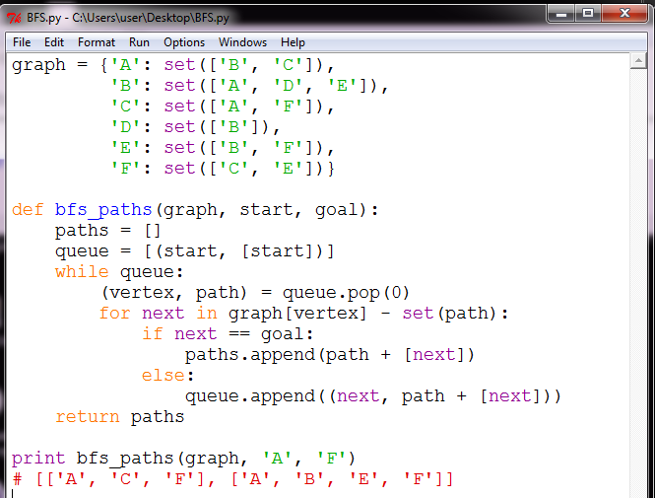
Breadth First using Python

Slide 11
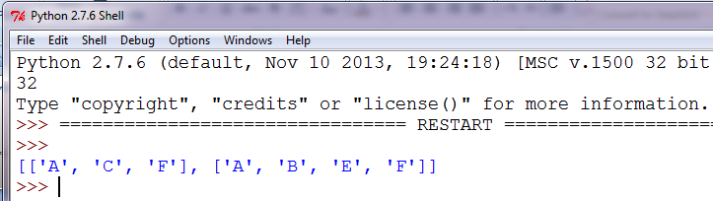
Breadth First using Python

Slide 12
Depth First Search
Strategy: expand the deepest unexpanded node.
Implementation: a LIFO queue (stack).

Slide 13
Depth First Search
The queue evolves like this
A
B C D
B C J
B C P Q
B C P U
B C P
B C
B G H I
B G H
B G N O
B G N R S T
B G N R S
B G N R V
B G N R
B G N
B G
B
E F
E M
E
K L
K

Slide 14
Depth First using Python
graph = {'A': set(['B', 'C']),
'B': set(['A', 'D', 'E']),
'C': set(['A', 'F']),
'D': set(['B']),
'E': set(['B', 'F']),
'F': set(['C', 'E'])}

Slide 15
Depth First using Python
def dfs_paths(graph, start, goal):
paths = []
stack = [(start, [start])]
while stack:
(vertex, path) = stack.pop()
for next in graph[vertex] - set(path):
if next == goal:
paths.append(path + [next])
else:
stack.append((next, path + [next]))
return paths
print dfs_paths(graph, 'A', 'F')
# [['A', 'C', 'F'], ['A', 'B', 'E', 'F']]

Slide 16
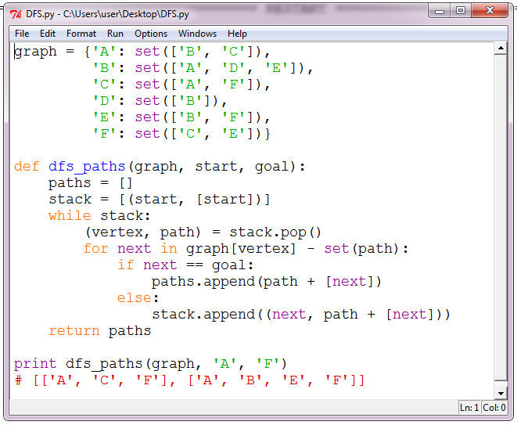
Depth First using Python

Slide 17
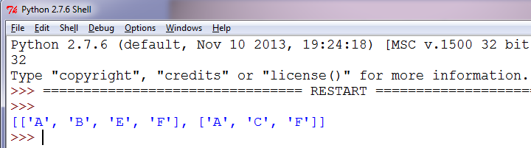
Depth First using Python

Slide 18
Depth First Iterative Deepening Search
Strategy:
A depth-limited search is run repeatedly, increasing the depth limit with each iteration until it reaches d, the depth of the shallowest goal state.

Slide 19
Iterative Deepening Search
The queue evolves like this
Depth = 1
A
B C D
B C
B
Depth = 2
A
B C D
B C J
B C
B G H I
B G H
B G
B
E F
E

Slide 20
Iterative Deepening Search
The queue evolves like this
Depth = 3
A
B C D
B C J
B C P Q
B C P
B C
B G H I
B G H
B G N O
B G N
B G
B
E F
E M
E
K L
K
Depth = 4
...

Slide 21
Iterative Deepening using Python
graph = {'A': set(['B', 'C']),
'B': set(['A', 'D', 'E']),
'C': set(['A', 'F']),
'D': set(['B']),
'E': set(['B', 'F']),
'F': set(['C', 'E'])}

Slide 22
Iterative Deepening using Python
def dfs_paths(graph, start, goal, limit):
paths = []
stack = [(start, [start])]
while stack:
(vertex, path) = stack.pop()
depth = len(path)
for next in graph[vertex] - set(path):
if next == goal:
paths.append(path + [next])
else:
if(depth+1<=limit):
stack.append((next, path + [next]))
return paths

Slide 23
Iterative Deepening using Python
def IDDFS(graph, start, goal):
for i in range(1, 4+1):
paths=dfs_paths(graph, start, goal, limit=i)
if(paths):
print paths
IDDFS(graph, 'A', 'F')
## [['A', 'C', 'F']]
## [['A', 'B', 'E', 'F'], ['A', 'C', 'F']]
## [['A', 'B', 'E', 'F'], ['A', 'C', 'F']]

Slide 24
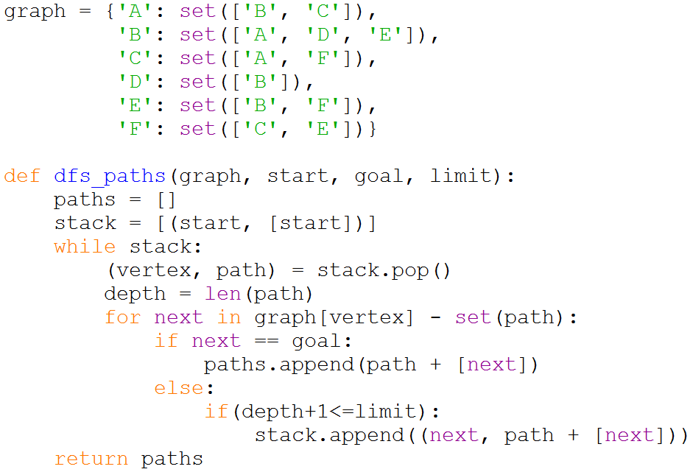
Iterative Deepening using Python

Slide 25
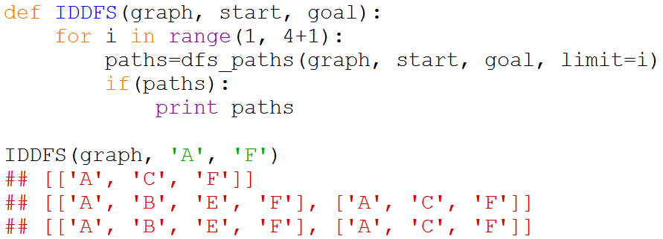
Iterative Deepening using Python

Slide 26
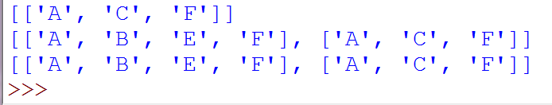
Iterative Deepening using Python

Slide 27
Sudoku (DFS or BFS)?

Slide 28
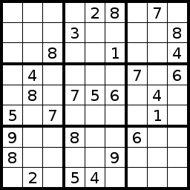
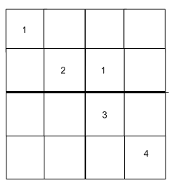
Ex.: Sudoku game
4*4 Sudoku game
9*9 Sudoku game

Slide 29
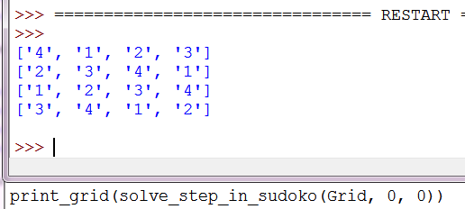
Ex.: Sudoku game

Slide 30
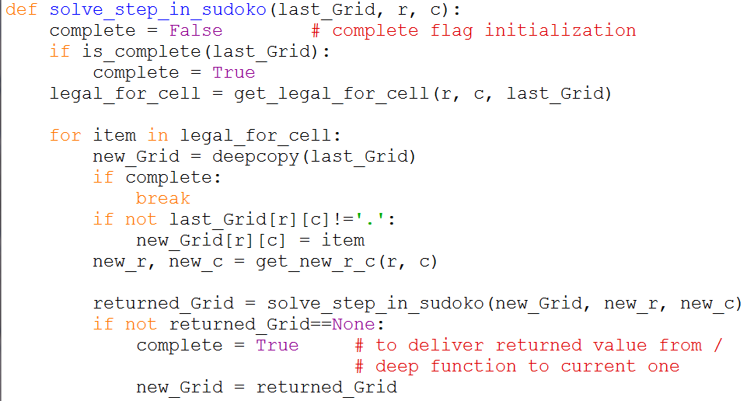
Ex.: Sudoku game

Slide 31
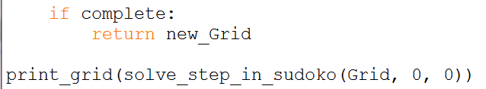
Ex.: Sudoku game

Slide 32
Sudoku (DFS or BFS)?
Sudoku is a CSP (Constraint satisfaction problem).
CSP is solved by Backtracking, Constraints Propagation

Slide 33
Sudoku (DFS or BFS)?
Constraints Propagation (8 queen)
Place a queen in a square
Remove the attacked squares from future consideration
Count the number of non-attacked squares in every row and column
Place a queen in a row or column with minimum number
Remove the attacked squares from future consideration
Repeat

Slide 34
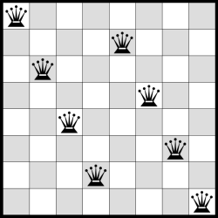
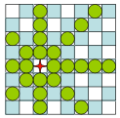
Sudoku (DFS or BFS)?
Constraints Propagation (8 queen)

Slide 35
Sudoku (DFS or BFS)?
Backtracking Algorithm
Backtrack is to return by the same route by which one has come.
Backtracking is an algorithm that incrementally builds candidates to the solutions, and abandons each partial candidate c("backtracks") as soon as it determines that c cannot possibly be completed to a valid solution.
Backtracking essentially is a depth-first algorithm using recursion.

Slide 36
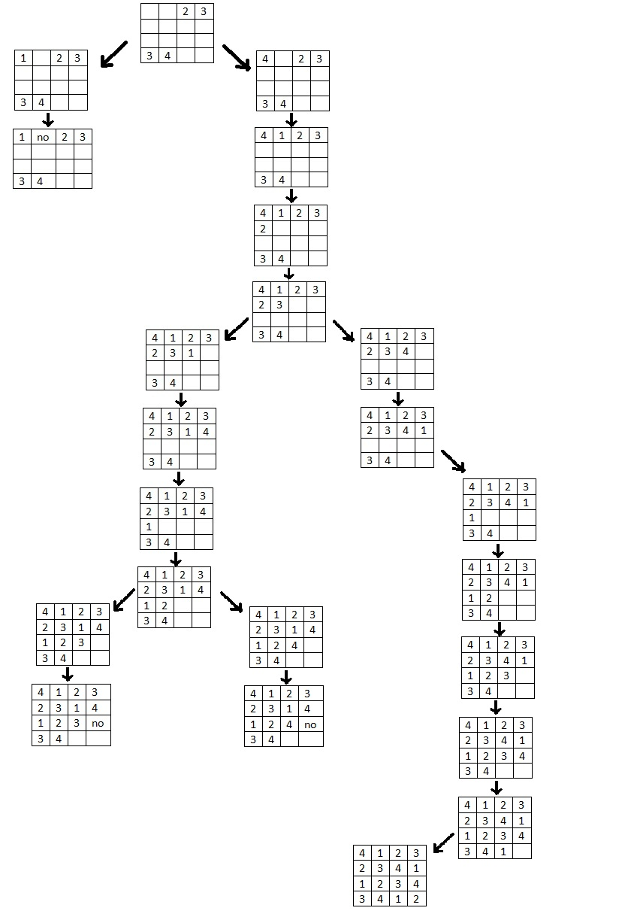
Sudoku (DFS or BFS)?
Sudoku is considered as depth first algorithm
Notes:
Check outside the presentation

Slide 37
Code
The complete code at
https://github.com/ahmed-elhelow/AI-class
E-mail: Ahmed.elhelow@90daraga.com

